Slide 1


ONLINE BOOK STORE
WEDDING PLAN MANAGEMENT
MAJOR PROJECT (GROUP -8)
MINOR PROJECT (GROUP – 5)

Slide 2

WEDDING PLAN MANAGEMENT
Our wedding plan management website is designed to simplify this journey, offering you a seamless, stress-free way to organize every detail of your special day. From tracking your budget and managing guest lists to coordinating with vendors and creating a personalized timeline, our platform provides all the tools you need in one convenient place. With user-friendly features and customizable options, you can ensure that your wedding reflects your unique style and vision. Let us help you turn your dream wedding into a reality, effortlessly and joyfully.

Slide 3
GOAL
The goal of a wedding plan management website is to provide couples with a centralized, user-friendly platform to efficiently organize, plan, and manage their wedding. This includes tools for budget tracking, guest management, vendor coordination, task organization, and providing inspiration, all while ensuring privacy and mobile accessibility.
WEDDING PLAN MANAGEMENT

Slide 4
WEDDING PLAN MANAGEMENT
IDE | VS CODE, STS 4
DATABASE | MY SQL
BACK END | JAVA, SPRINGBOOT
FRONT END | REACT JS
PROCESSOR | CPU 1.5GHz Dual core or higher
RAM | 4 GB OR HIGHER
HARD DISK DRIVE | DISK 10 GB OR HIGHER
SOFTWARE
HARDWARE
SOFTWARE AND HARDWARE REQUIREMENT SPECIFICATIONS

Slide 5
Constructive Cost Estimation Model (COCOMO)
Barry Boehm proposed COCOMO (Constructive Cost Estimation Model) in 1981. COCOMO is one of the most generally used software estimation models in the world. COCOMO predicts the efforts and schedule of a software product based on the size of the software.
Type of software : ORGANIC
A software project is said to be an organic type if the team size required is adequately small, the problem is well understood and has been solved in the past and also the team members have a nominal experience regarding the problem.
CALCULATION
WEDDING PLAN MANAGEMENT
Lines of code = 2000
KLOC = 2
Development Effort = 2.4 * (KLOC) 1.05 PM
= 2.4 * (2) 1.05 PM
= 4.8 * 1.05 PM
= 5.04 PM
Development Time = 2.5 * (Effort) 0.38 Month
_{= (12.6) 0.38 Month}
_{= 5 Months Approx}

Slide 6
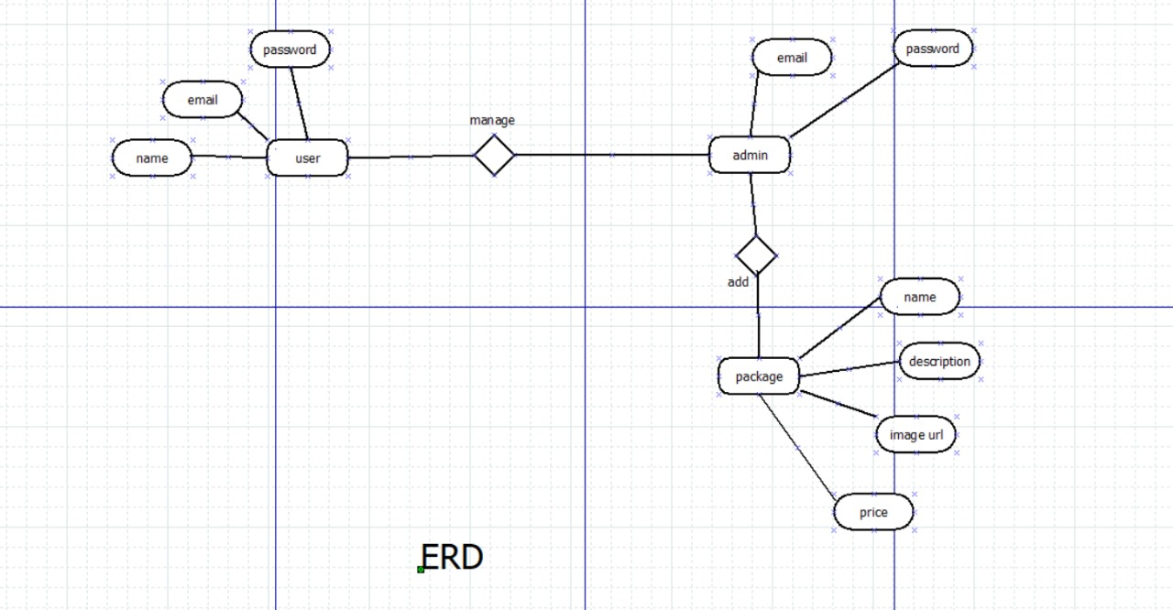

ERD
Entity-Relationship
Diagram
An entity relationship diagram (ERD), also known as an entity relationship model, is a graphical representation that depicts relationships among people, objects, places, concepts or events within an information technology (IT) system. An ERD uses data modeling techniques that can help define business processes and serve as the foundation for a relational database.
DATA FLOW DIAGRAM
A data flow diagram (DFD) is a graphical or visual representation using a standardized set of symbols and notations to describe a business's operations through data movement.

Slide 7

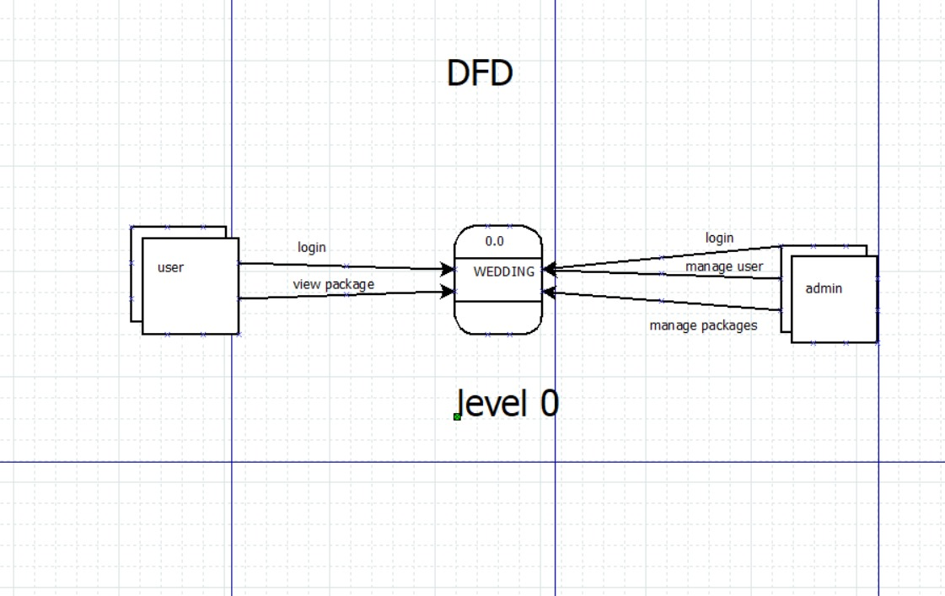
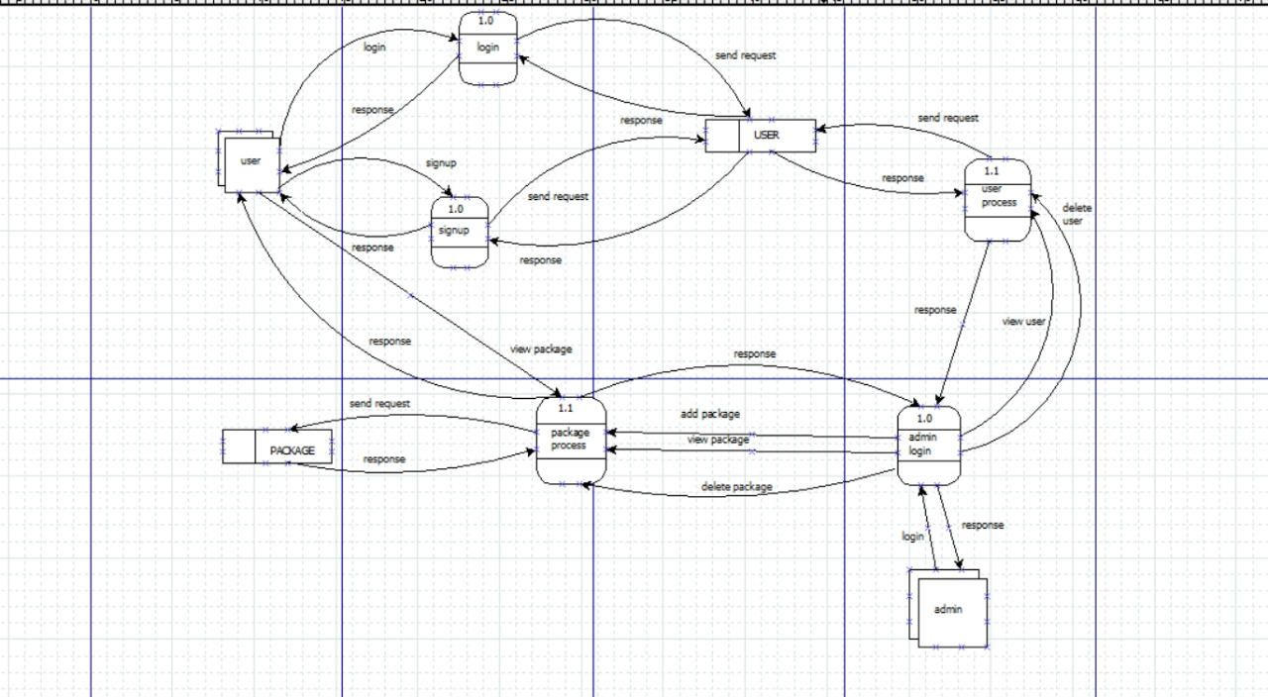
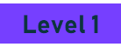
Level 0
DATA FLOW DIAGRAM
A data flow diagram (DFD) is a graphical or visual representation using a standardized set of symbols and notations to describe a business's operations through data movement.

Slide 8

TESTING
The testing process focuses on the logical intervals of the software ensuring that all statements have been tested and on functional intervals conducting tests to uncover errors and ensure that defined input will produce actual results that agree with the required results, program-level testing and module-level testing integrated and carried out.
Testing Methods:
There are two major types of testing they are:
White Box Testing
Black Box Testing
White Box Testing:
White box sometimes called Glass box testing is a test case design uses the control structure of the procedural design to drive test case.
WEDDING PLAN MANAGEMENT

Slide 9
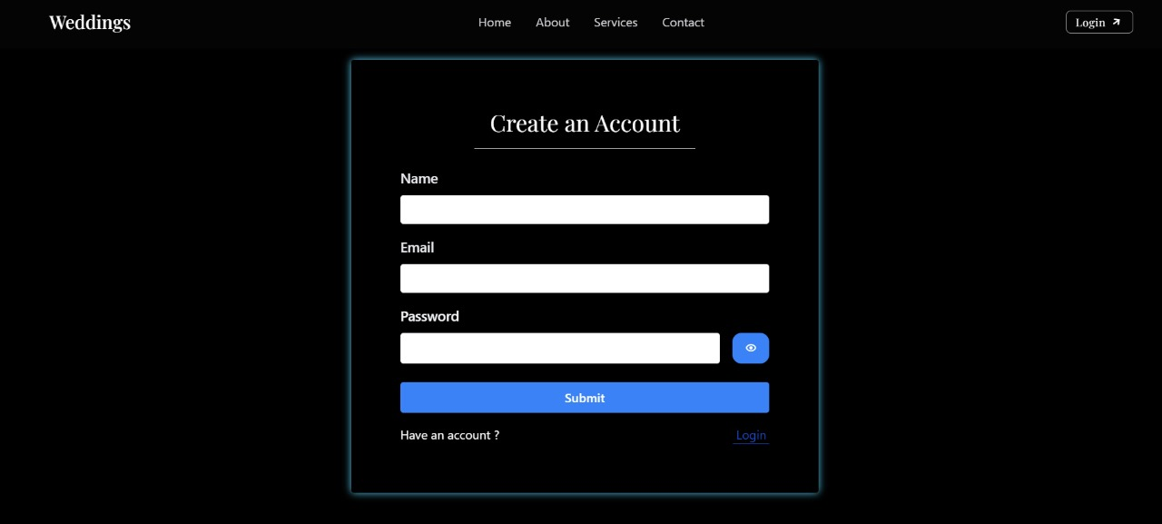

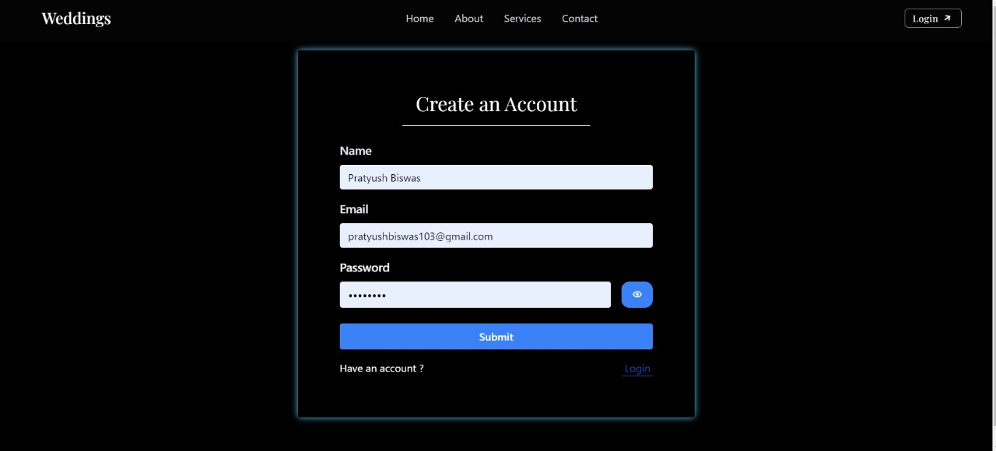
POSITIVE AND NEGATIVE TESTING
Any user can register in the website after entering necessary credentials. The details are then stored in a SQL database.
ONLINE BOOK STORE
POSITIVE TESTING : If a registered user tries to login with his pre-entered credentials, they can successfully enter the website and is greeted with a Congrats pop-up with their name being shown at the top of the website navbar

Slide 10
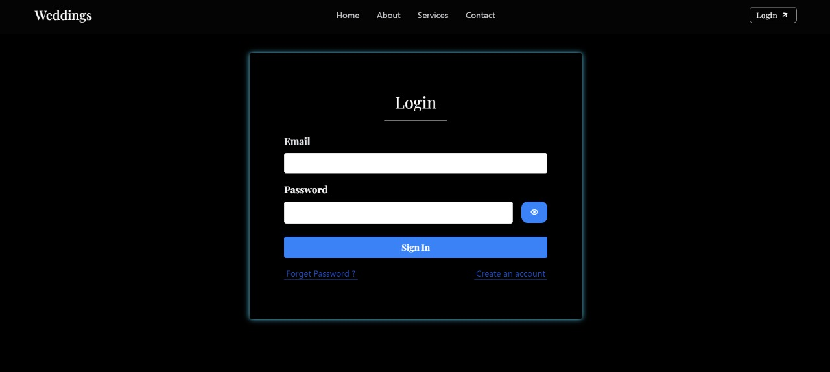
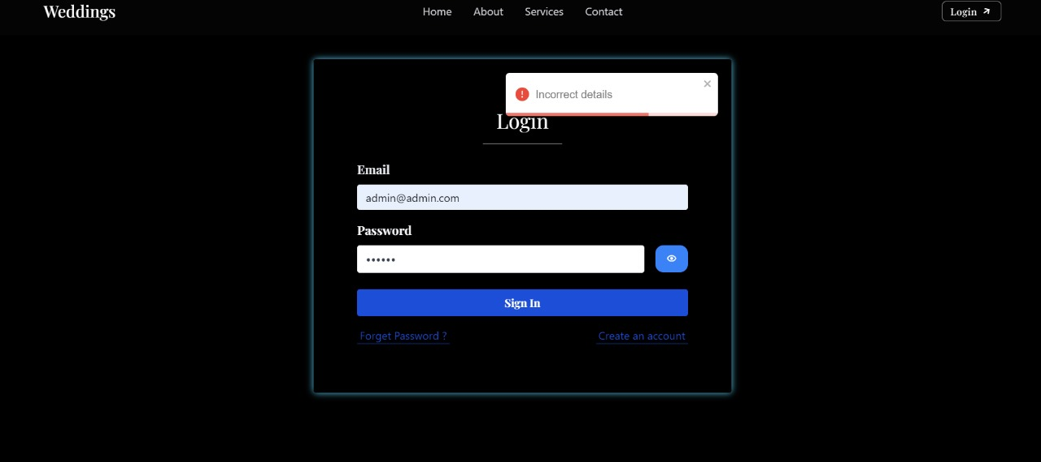
POSITIVE AND NEGATIVE TESTING
ADMIN LOGIN : The admin has a pre-recorded and specific set of login credentials that he uses to access a separate interface with admin-specific tasks.
WEDDING PLAN MANAGEMENT
ONLINE BOOK STORE
NEGATIVE TESTING : If an user enters wrong credentials during login, or is trying to login without registering, an error pop-up is displayed on-screen. Thus, providing a negative output.

Slide 11



THE PROJECT

Slide 12

ONLINE BOOK STORE
WEDDING PLAN MANAGEMENT
HOME PAGE

Slide 13
WEDDING PLAN MANAGEMENT
ONLINE BOOK STORE
REGISTRATION PAGE

Slide 14
ONLINE BOOK STORE
WEDDING PLAN MANAGEMENT
LOGIN PAGE

Slide 15
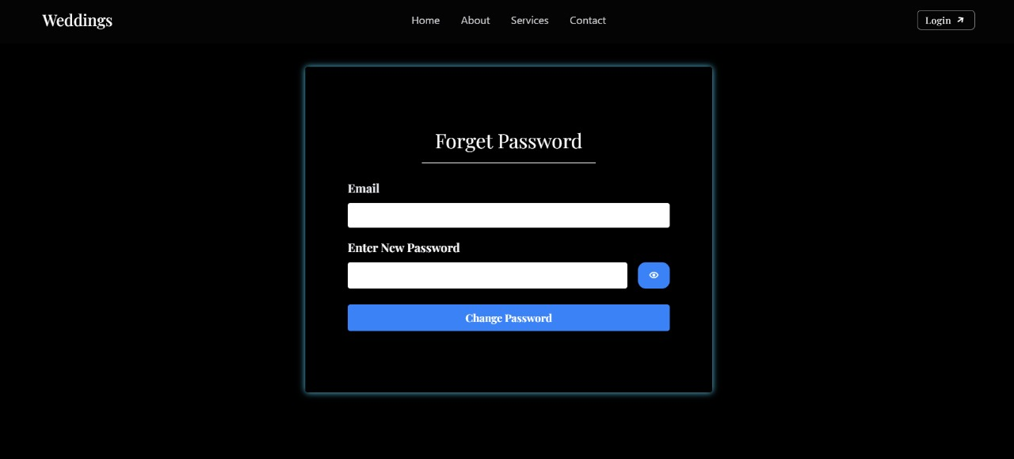
ONLINE BOOK STORE
WEDDING PLAN MANAGEMENT
Forget Password

Slide 16
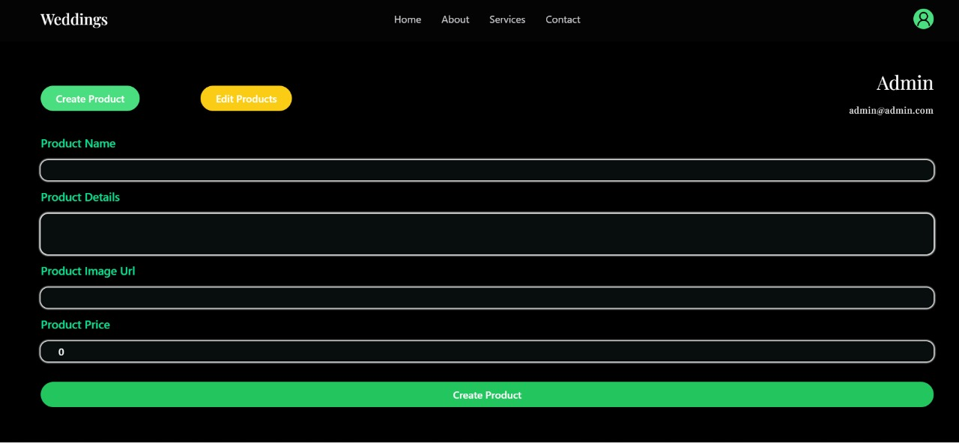
ONLINE BOOK STORE
WEDDING PLAN MANAGEMENT
Admin Section

Slide 17
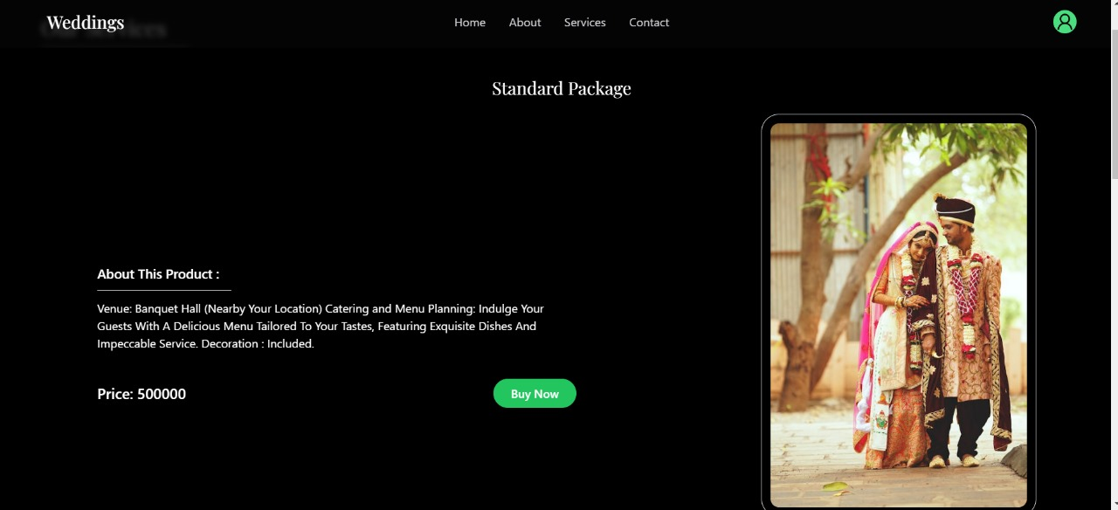
ONLINE BOOK STORE
WEDDING PLAN MANAGEMENT
Admin Section

Slide 18
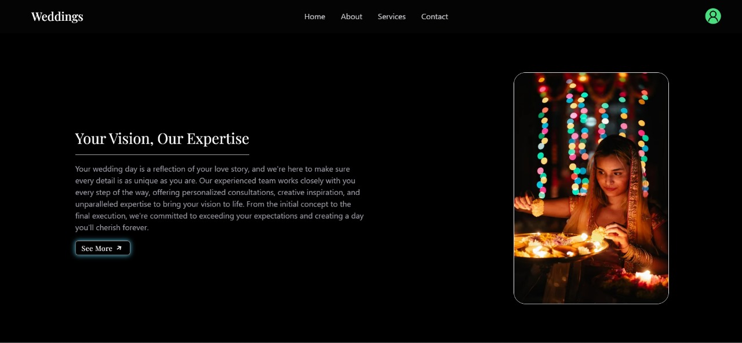
WEDDING PLAN MANAGEMENT
ONLINE BOOK STORE
ABOUT PAGE

Slide 19
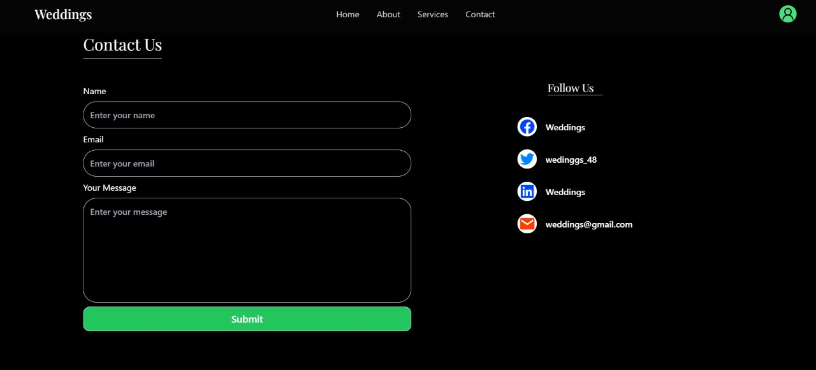
WEDDING PLAN MANAGEMENT
ONLINE BOOK STORE
CONTACT SECTION

Slide 20
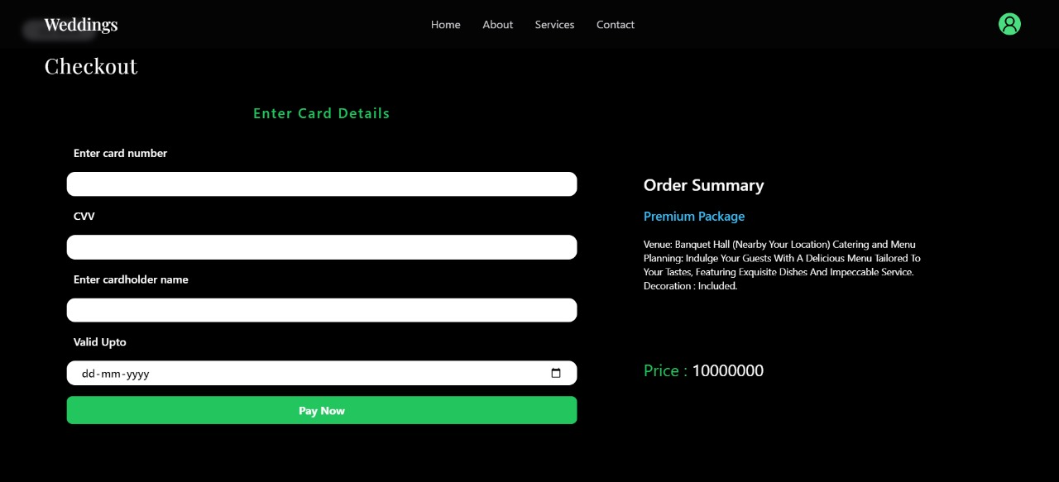
ONLINE BOOK STORE
WEDDING PLAN MANAGEMENT
BOOKING SECTION

Slide 21
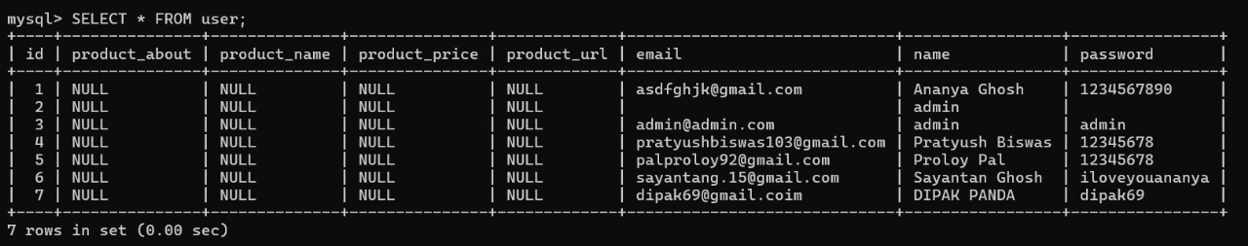
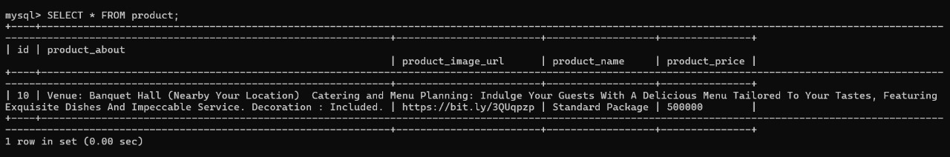
TABLE DETAILS
DETAILS
USER
ONLINE BOOK STORE
WEDDING PLAN MANAGEMENT
DETAILS
PRODUCT

Slide 22

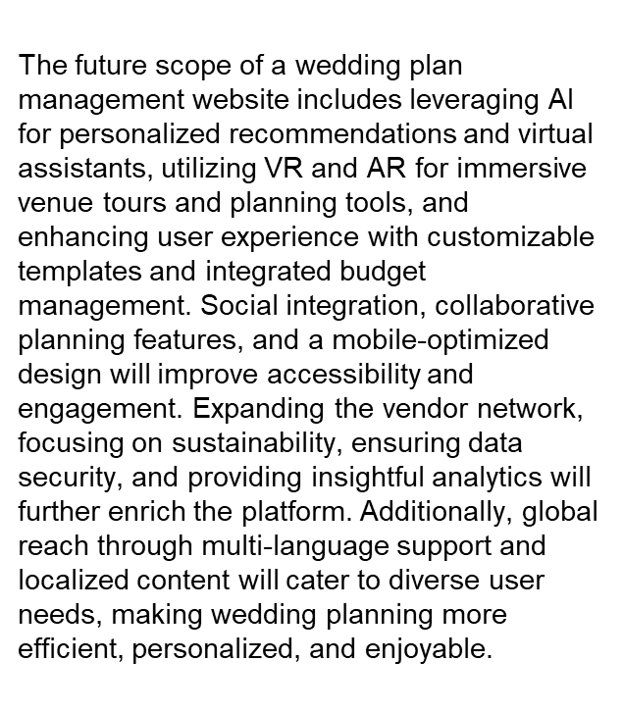

FUTURE SCOPE
ONLINE BOOK STORE
WEDDING PLAN MANAGEMENT

Slide 23
01
02
W3SCHOOLS
TUTORIALS POINT
https://www.w3schools.com/java/java_intro.aspwww.wi kipedia.com
https://www.tutorialspoint.com/java
WEDDING PLAN MANAGEMENT
ONLINE BOOK STORE
03
OpenAI
https://chat.openai.com
BIBLIOGRAPHY

Slide 24




THANKS!
THANKS!

